Slide 1
Report
Absenteeism at work

Slide 2
AGENDA
Data Exploration
Data Modeling
Insights
Recommendations
Q/A

Slide 3
Exploratory Data Analysis
Total Records: 740
Total Attributes: 21
93% Non smoker
81% Have Pet
Most Records Of Season 4 #195
Most Records Of Reason 23 #149
Most Records Of March Month #87
Most Records Of Monday #161
Most Records Of Absenteeism #8 Hour

Slide 4
Exploratory Data Analysis
Uni variate analysis

Slide 5
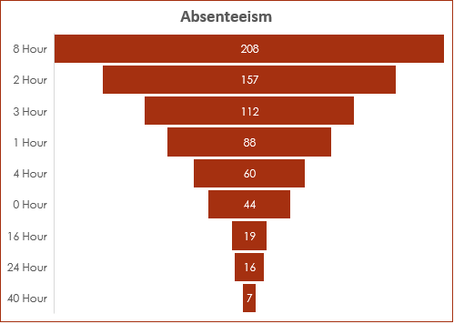
Exploratory Data Analysis
Uni variate analysis

Slide 6
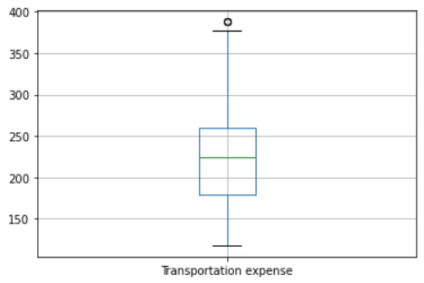
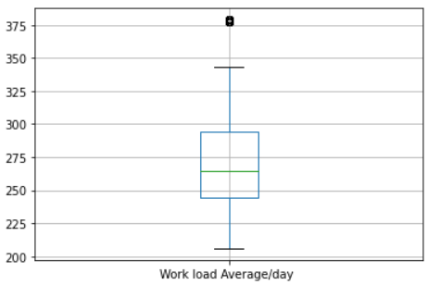
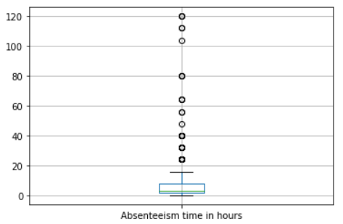
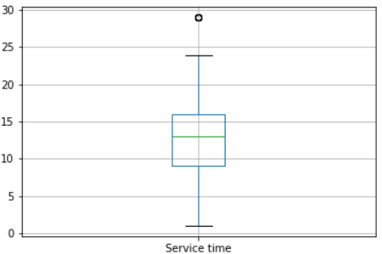
Exploratory Data Analysis

Slide 7
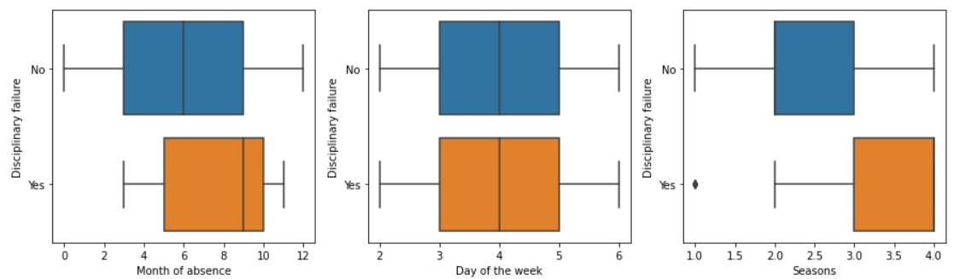
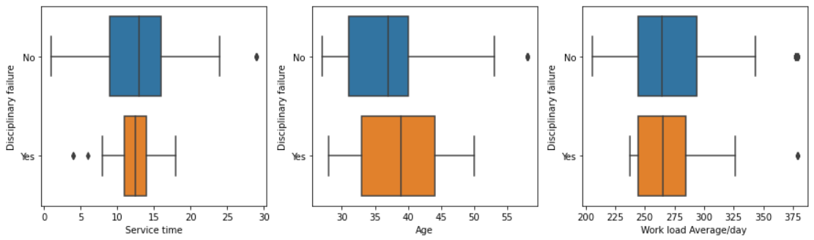
Exploratory Data Analysis

Slide 8
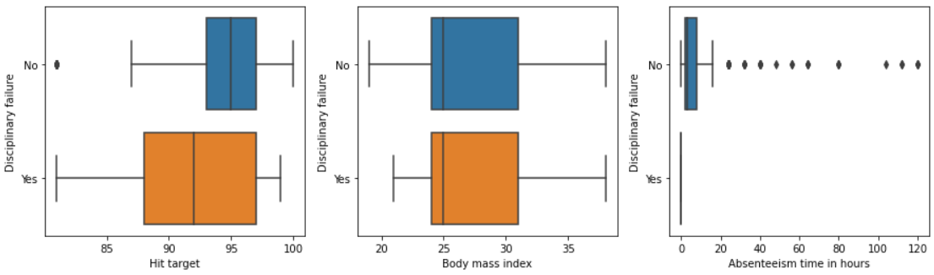
Exploratory Data Analysis

Slide 9
Exploratory Data Analysis

Slide 10
Data Modeling – Top 10 Model Performance

Slide 11
Data Modeling – 25 Model Performance

Slide 12
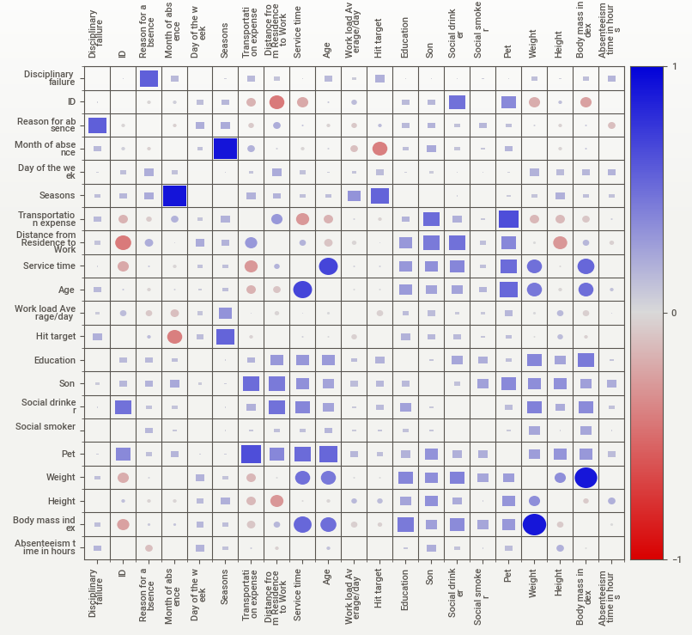
Exploratory Data Analysis

Slide 13
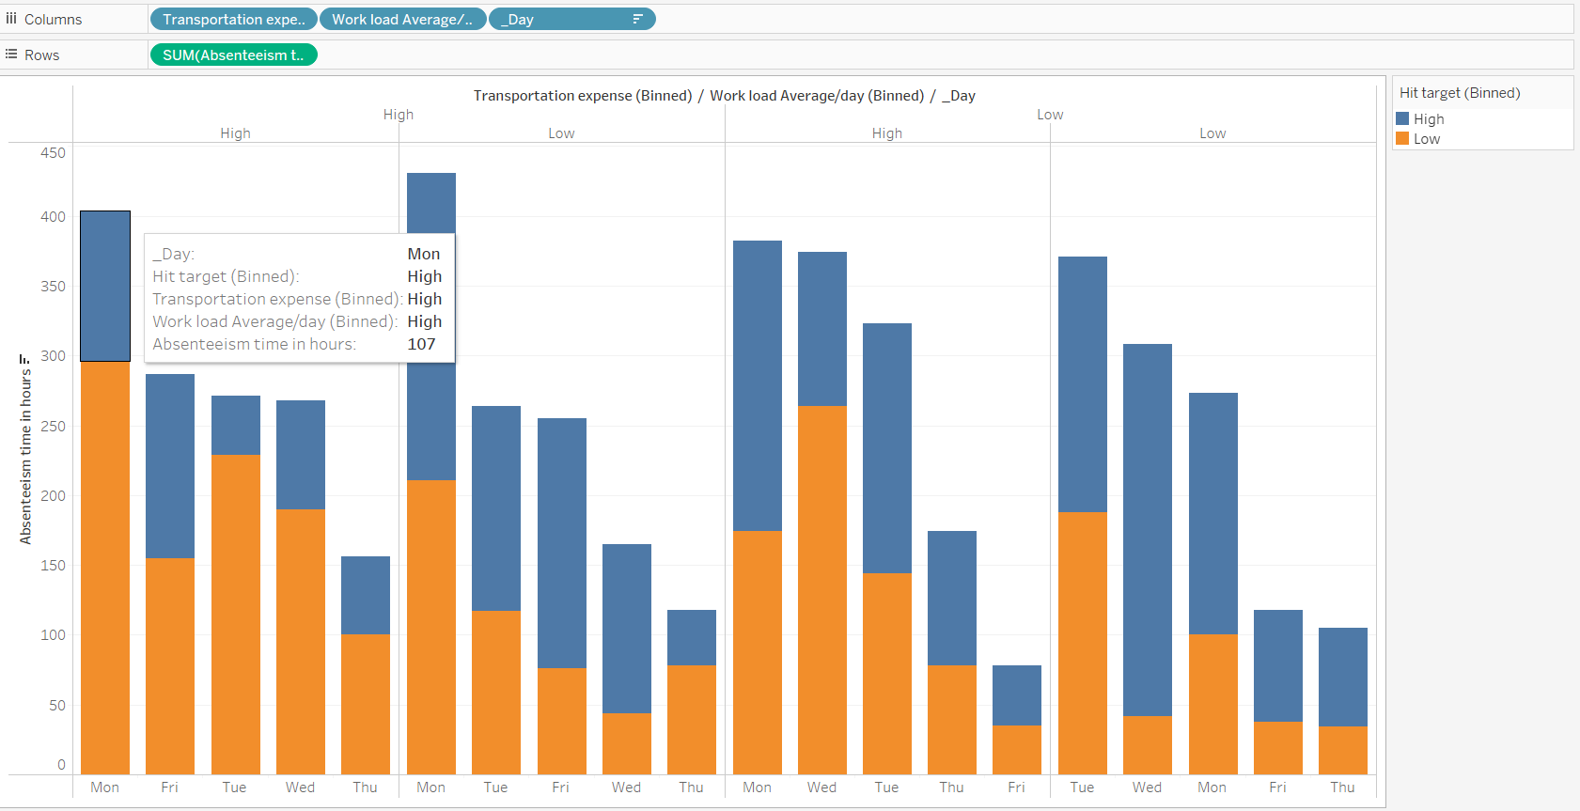
Based on Transportation exp., work load, hit target and day of the week, how absenteeism varies across month?

Slide 14
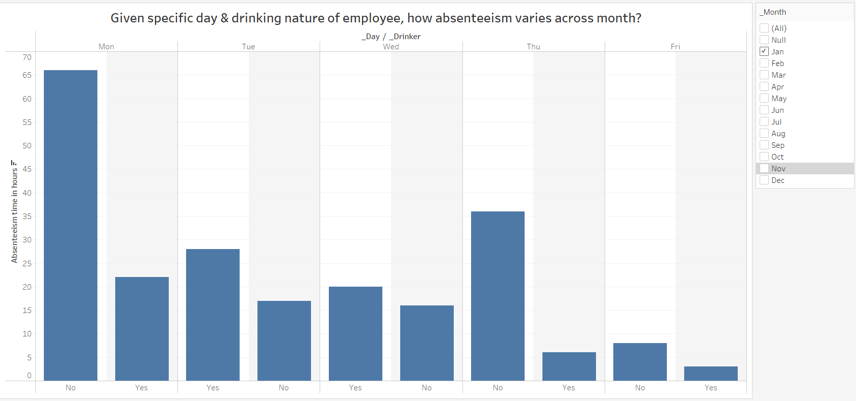
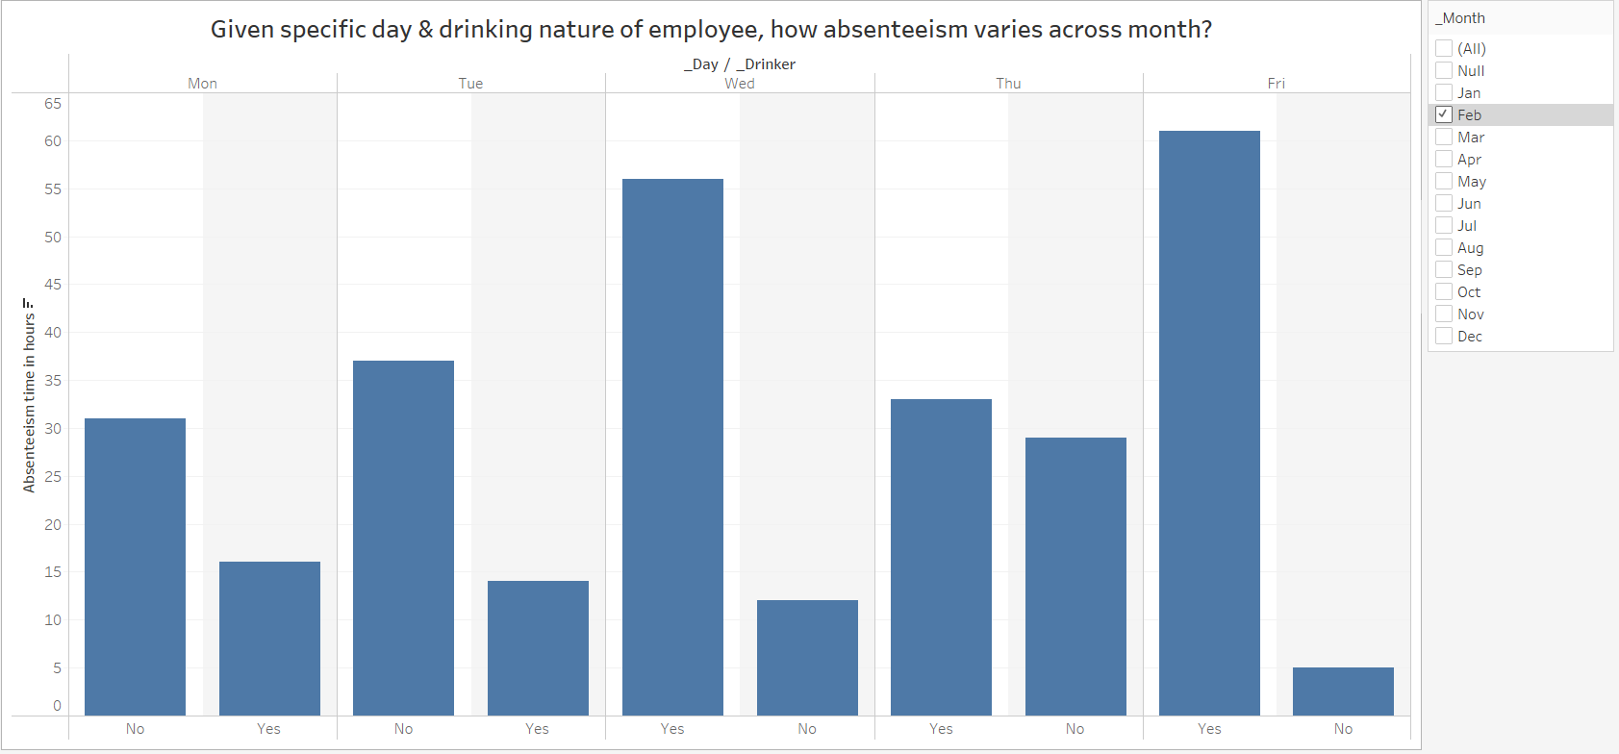
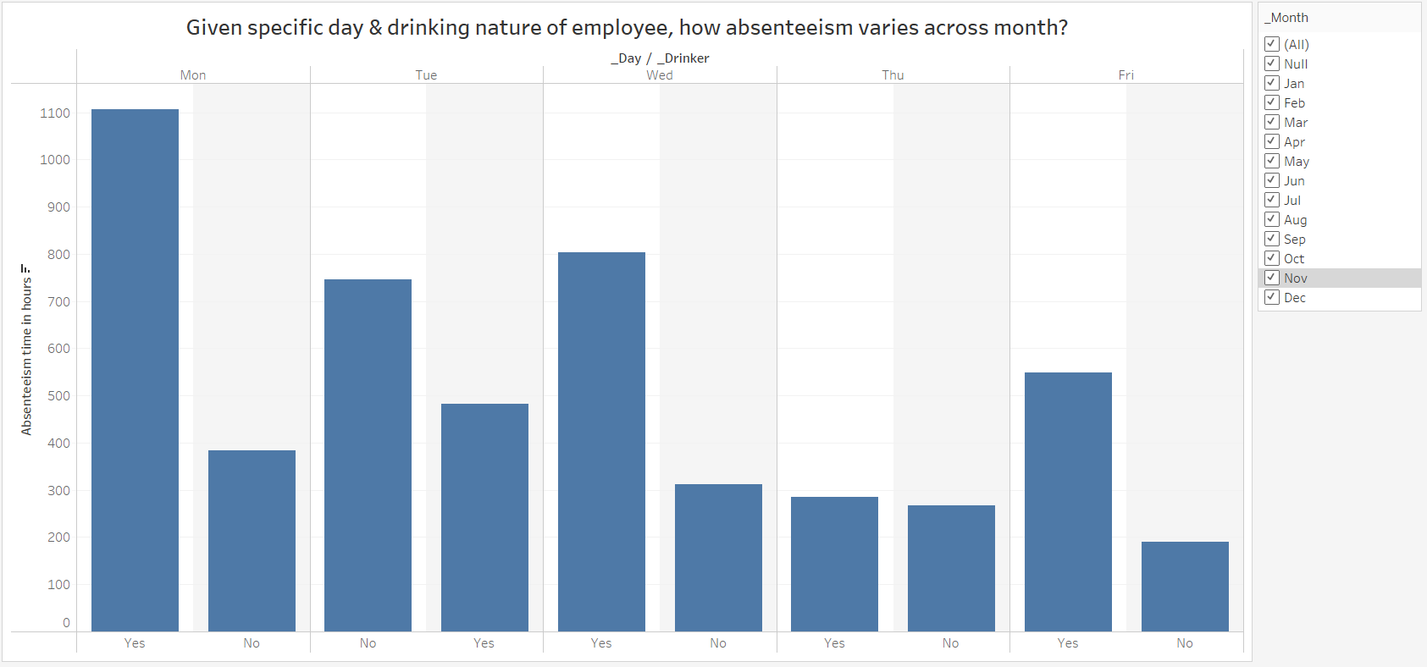
Given specific day & ‘drinking nature’ of employee, how absenteeism varies across month?

Slide 15
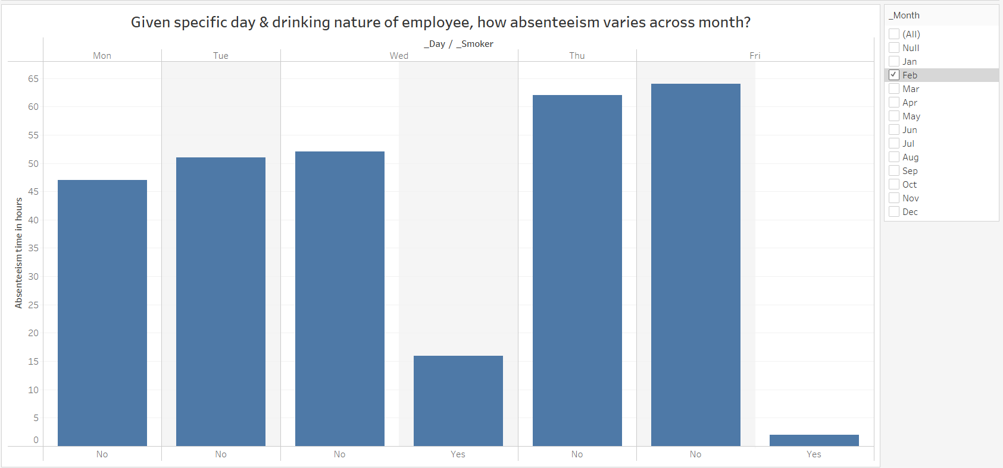
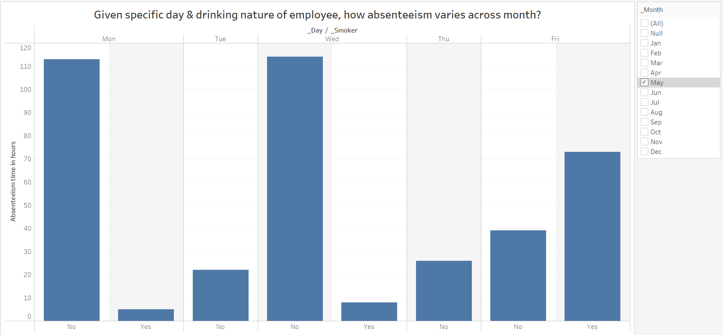
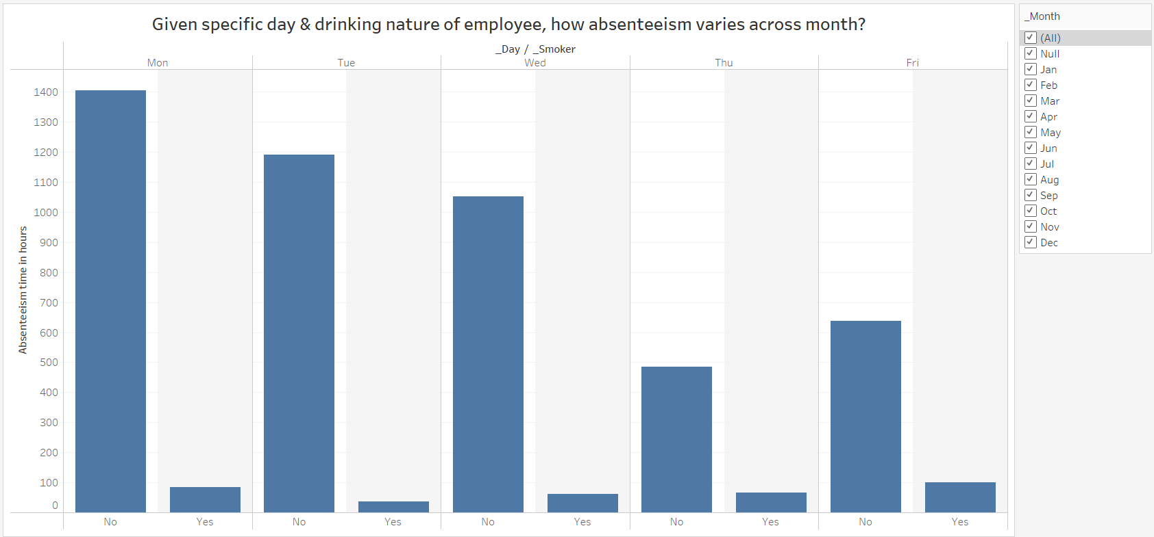
Given specific day & ‘smoking nature’ of employee, how absenteeism varies across month?

Slide 16
Given specific day & drinking nature of employee, how absenteeism varies across month?

Slide 17
Insights
Reason for absence is highly correlated with _Disciplinary failure.
Son is highly correlated with _pet.
Hit target is highly correlated with _month and 1 other fields.
Age is highly correlated with Service time and 1 other fields.
Service time is highly correlated with Age and 1 other fields.
Distance from Residence to Work is highly correlated with _drinker and 1 other fields.
Work load Average/day is highly correlated with _month.
_smoker is highly correlated with Education.
_Disciplinary failure is highly correlated with Reason for absence.
_month is highly correlated with Hit target and 2 other fields.
_drinker is highly correlated with Age and 2 other fields.
Transportation expense is highly correlated with _pet.
Education is highly correlated with Distance from Residence to Work and 2 other fields.
_pet is highly correlated with Son and 1 other fields.
Seasons is highly correlated with Hit target and 1 other fields.
Body mass index is highly correlated with Service time .
Son is highly correlated with _pet.
_month is highly correlated with Hit target and 2 other fields.
_drinker is highly correlated with Distance from Residence to Work .
Transportation expense is highly correlated with _pet.
_pet is highly correlated with Son and 1 other fields.
Hit target is highly correlated with _month.
Age is highly correlated with Service time .
Service time is highly correlated with Age .
Distance from Residence to Work is highly correlated with _drinker.
Seasons is highly correlated with _month.
Work load Average/day is highly correlated with _month.

Slide 18
Resources Used – Check Online
GitHub Project Link: https://github.com/theshreyansh/Absenteeism-at-work
Tableau Project Link: https://public.tableau.com/views/PeojectAboutAbsenteeismAtWork/_Smoking?:language=en-US&publish=yes&:display_count=n&:origin=viz_share_link

Slide 19

Thank You

